Slide 1










Alan Turing and the Turing Test
Relevance in the Age of ChatGPT and Generative AI

Slide 2








Who Was Alan Turing?
Alan Turing was a British mathematician, logician, and cryptanalyst who lived from 1912 to 1954. His groundbreaking work laid the foundation for modern computing and artificial intelligence.
Cryptographic Pioneer
Father of Computer Science
Father of AI
Played a crucial role in breaking the German Enigma code during World War II, potentially shortening the war by several years.
Formulated the concept of the universal Turing machine and laid the groundwork for theoretical computer science.
Proposed the Turing Test in 1950, establishing a benchmark for machine intelligence that remains influential today.
Timeline
1912
1954
1942-1945
Enigma Codebreaking

Slide 3















The Turing Test: A Revolutionary Idea
In 1950, Turing posed the question "Can machines think?" Instead of getting caught up in philosophical debates about consciousness, he proposed a practical test.
The "Imitation Game"
Behavioral Criterion
Originally called the "Imitation Game," the test has humans converse with both a human and a machine through text.
Turing proposed a behavioral criterion for machine intelligence based on conversation, not defining intelligence or consciousness.
Philosophical Shift
Turing shifted the conversation from "what is thinking?" to "what does thinking look like?" This pragmatic approach remains valuable today.
Lasting Impact
The test established conversational ability as a benchmark for AI development that many modern systems are still evaluated against.
Human
Machine
If the evaluator cannot reliably distinguish the machine from the human, the machine is said to have passed the test.

Slide 4










How the Turing Test Works
The Turing Test determines if a machine can exhibit intelligent behavior indistinguishable from humans. A human evaluator engages with both a human and a machine through text.
Human
Evaluator
Machine
Conversationalist
Distinguishing
Conversationalist
Test Criteria
Turing's Insight
If evaluator cannot distinguish machine from human, it passes the test
If a machine can convincingly mimic human conversation, we might as well consider it intelligent for practical purposes.
Turing wasn't defining intelligence or consciousness
Proposing behavioral criterion for machine intelligence
Key distinction: Focus on observable behavior rather than internal states.

Slide 5







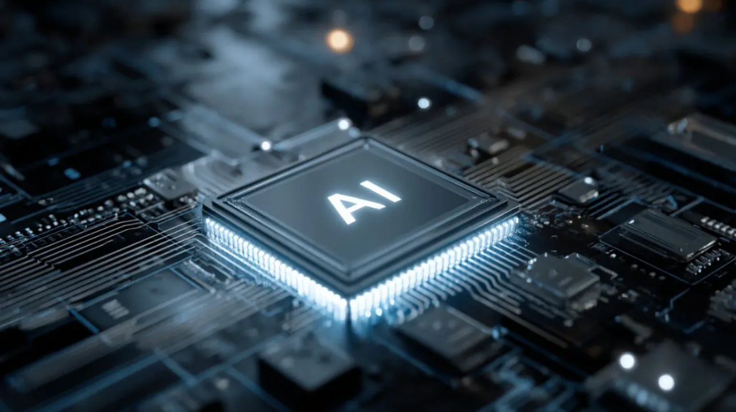






Modern AI: ChatGPT and Generative Systems
Today's AI systems like ChatGPT can engage in remarkably human-like conversations and demonstrate unprecedented linguistic capabilities.
Conversational Abilities
Writing Skills
Engage in human-like dialogues on diverse topics.
Compose essays, stories, and code with human-like quality.
Knowledge Retrieval
Creative Generation
Answer complex questions with accurate information.
Create poetry, music, and art with creative flair.
Modern AI processors power today's generative systems
These systems demonstrate capabilities that would have seemed like science fiction just a decade ago.

Slide 6












The Great Debate: Have We Passed the Test?
A central question in AI today: Have modern language models like ChatGPT truly passed Turing's test for machine intelligence? Both sides present compelling evidence.
Arguments For
Arguments Against
Modern AI has essentially passed the Turing Test in many brief conversations
Modern AI can still produce nonsensical or contradictory responses
Systems demonstrate unprecedented linguistic capabilities and contextual understanding
Lacks genuine understanding of the physical world and real-world context
In many interactions, people cannot tell they're talking to an AI
Cannot truly reason in certain complex ways or demonstrate consciousness
Perhaps the real question is: What makes intelligence, understanding, and humanity?

Slide 7










Why the Turing Test Still Matters
Despite being over 70 years old, the Turing Test remains a relevant framework for understanding machine intelligence and its relationship to human intelligence.
Shift in Perspective
Benchmark for AI
Deep Questions
Sh shifted the conversation from "what is thinking?" to "what does thinking look like?" This pragmatic approach remains valuable today.
Established conversational ability as a benchmark for AI development. Many modern AI systems are still evaluated on their dialogue capabilities.
Raises fundamental questions we still grapple with: What is intelligence? What makes us human? Can machines truly understand, or just simulate understanding?

Slide 8

















Limitations and New Challenges
Modern AI has revealed limitations in Turing's original concept. The test doesn't measure important aspects of intelligence and raises questions about transparency and ethics.
What the Turing Test Doesn't Address
New Challenges for the AI Era
Creativity
Continuous Learning
Can produce text but lacks genuine creative insight
AI cannot adapt and learn from new experiences
Emotional Intelligence
Transparency vs. Deception
Cannot truly understand emotions or empathize
Should AI identify itself as machine or deceive humans?
Ethical Reasoning
Genuine Understanding
Lacks moral understanding and values
AI can simulate understanding without actual comprehension
The Turing Test reveals more about our questions than about machine intelligence.

Slide 9










Modern Alternatives and Extensions
Researchers have proposed new tests to address limitations of the original Turing Test, providing more comprehensive evaluation of AI capabilities.
Winograd Schema Challenge
Visual Turing Tests
Comprehensive Benchmarks
Tests common sense reasoning and understanding of language context beyond pattern matching.
Assesses image understanding and visual reasoning capabilities of AI systems.
Measure performance across multiple tasks and domains for holistic evaluation.
How Modern Tests Extend Turing's Vision
Address creativity and emotional intelligence
Evaluate ethical reasoning capabilities
Test continuous learning abilities
Provide transparent evaluation metrics
These modern approaches don't replace the Turing Test but complement it as we seek to better understand AI capabilities.

Slide 10










Conclusion: Turing's Lasting Legacy
Alan Turing gave us a framework for thinking about machine intelligence that remains influential decades later, even as AI has evolved far beyond his wildest expectations.
Shift in Perspective
Ongoing Relevance
Transformed the question from "Can machines think?" to "What does thinking look like?"
The test continues to guide AI development and raises fundamental questions about intelligence and understanding
Human Reflection
Incomplete Picture
Forces us to examine what makes us human in an increasingly AI-integrated world
The test is just one piece of a larger puzzle in our quest to understand intelligence
"Perhaps the real legacy of the Turing Test isn't whether machines can fool us, but that it forces us to continually examine what we mean by intelligence, understanding, and what it means to be human."

